Slide 1
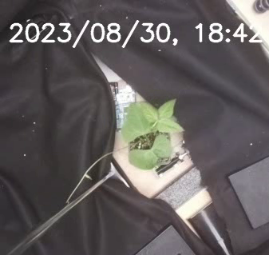
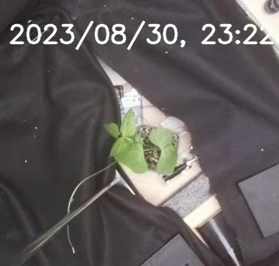

Contact starts
No twine after 5 hours
$$Ω_{CN}$$
motor
support

